Slide 1
Design and Analysis of Algorithm
Greedy Methods
(Minimum Spanning Tree)
Lecture – 45 - 53

Slide 2
Overview
A greedy algorithm always makes the choice that looks best at the moment. (i.e. it makes a locally optimal choice in the hope that this choice will lead to a globally optimal solution).
The objective of this section is to explores optimization problems that are solvable by greedy algorithms.

Slide 3
Greedy Algorithm
In mathematics, computer science and economics, an optimization problem is the problem of finding the best solution from all feasible solutions.
Algorithms for optimization problems typically go through a sequence of steps, with a set of choices at each step.
Many optimization problems can be solved using a greedy approach.
Greedy algorithms are simple and straightforward.

Slide 4
Greedy Algorithm
A greedy algorithm always makes the choice that looks best at the moment.
That is, it makes a locally optimal choice in the hope that this choice will lead to a globally optimal solution.
Greedy algorithms do not always yield optimal solutions, but for many problems they do.
This algorithms are easy to invent, easy to implement and most of the time provides best and optimized solution.

Slide 5
Greedy Algorithm
Application of Greedy Algorithm:
  A simple but nontrivial problem, the activity-selection problem, for which a greedy algorithm efficiently computes a solution.
  In combinatorics,(a branch of mathematics), a ‘matroid’ is a structure that abstracts and generalizes the notion of linear independence in vector spaces. Greedy algorithm always produces an optimal solution for such problems. Scheduling unit-time tasks with deadlines and penalties is an example of such problem.

Slide 6
Greedy Algorithm
Application of Greedy Algorithm:
  An important application of greedy techniques is the design of data-compression codes (i.e. Huffman code) .
  The greedy method is quite powerful and works well for a wide range of problems. They are:
    Minimum-spanning-tree algorithms
      (Example: Prims and Kruskal algorithm)
    Single Source Shortest Path.
      (Example: Dijkstra's and Bellman ford algorithm)

Slide 7
Greedy Algorithm
Application of Greedy Algorithm:
  A problem exhibits optimal substructure if an optimal solution to the problem contains within it optimal solutions to subproblems.
  This property is a key ingredient of assessing the applicability of dynamic programming as well as greedy algorithms.
  The subtleties between the above two techniques are illustrated with the help of two variants of a classical optimization problem known as knapsack problem. These variants are:
    0-1 knapsack problem (Dynamic Programming)
    Fractional knapsack problem (Greedy Algorithm)

Slide 8
Greedy Algorithm
Problem 4: Minimum Spanning Tree problem
  Spanning Tree
    A tree (i.e., connected, acyclic graph) which contains all the vertices of the graph
  Minimum Spanning Tree
    Spanning tree with the minimum sum of weights
8
7
b
8
c
7
d
b
c
d
4
9
4
9
2
2
a
11
i
14
e
a
i
4
e
7
4
8
6
10
h
g
f
h
g
f
1
2
1
2

Slide 9
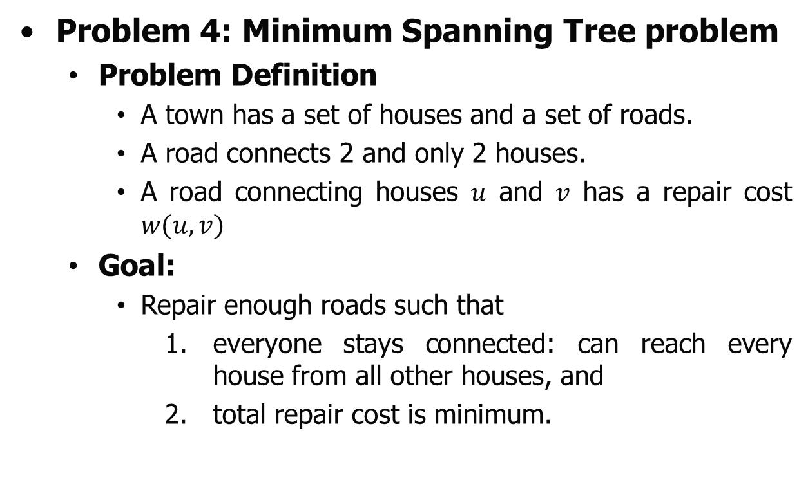
Greedy Algorithm
Problem 4: Minimum Spanning Tree problem
  Problem Definition
    A town has a set of houses and a set of roads.
    A road connects 2 and only 2 houses.
    A road connecting houses $u$ and $v$ has a repair cost $w(u,v)$
  Goal:
    Repair enough roads such that
      1. everyone stays connected: can reach every house from all other houses, and
      2. total repair cost is minimum.

Slide 10
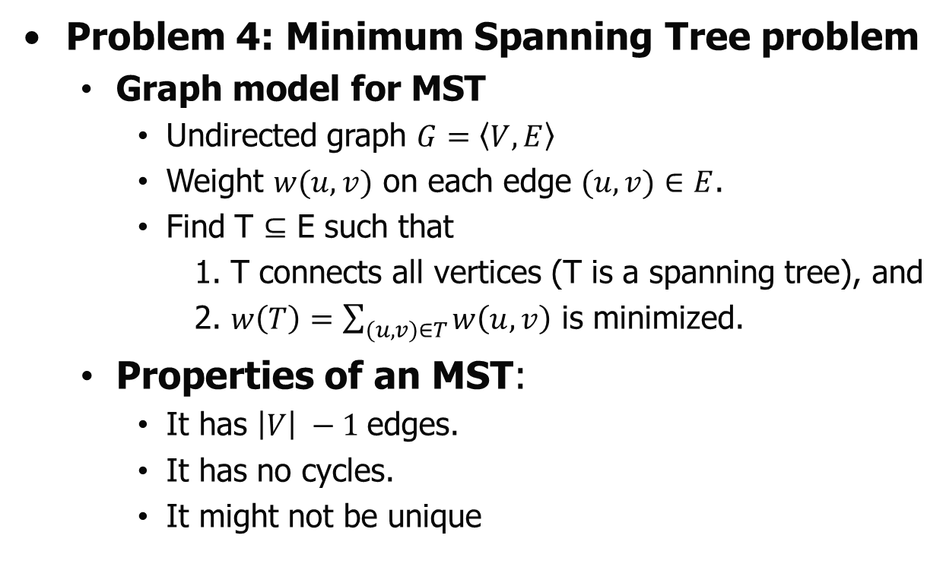
Greedy Algorithm
Problem 4: Minimum Spanning Tree problem
  Graph model for MST
    Undirected graph $G=\left\langle V,E\right\rangle$
    Weight $w(u,v)$ on each edge $(u,v)∈E$.
    Find T $⊆$ E such that
      1. T connects all vertices (T is a spanning tree), and
      2. $w\left(T\right)=\sum_{(u,v)∈T}{w\left(u,v\right)}$ is minimized.
  Properties of an MST:
    It has $\left|V\right| −1$edges.
    It has no cycles.
    It might not be unique

Slide 11
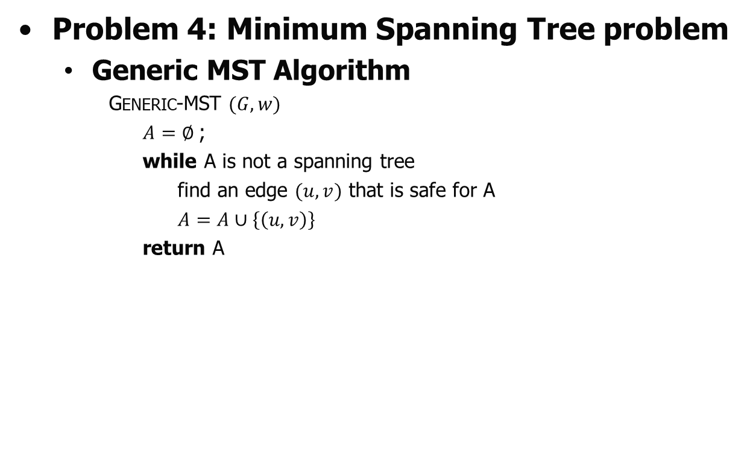
Greedy Algorithm
Problem 4: Minimum Spanning Tree problem
  Generic MST Algorithm
    Generic-MST $(G,w)$
    $A=∅$;
    while A is not a spanning tree
    find an edge $(u,v)$ that is safe for A
    $A=A∪\left\{\left(u,v\right)\right\}$
    return A

Slide 12
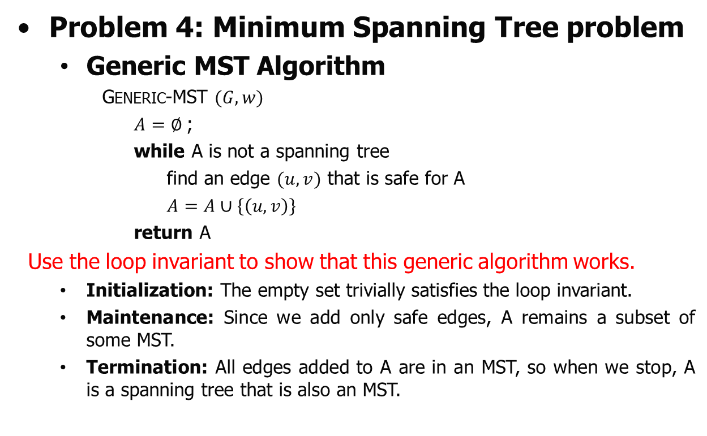
Greedy Algorithm
Problem 4: Minimum Spanning Tree problem
  Generic MST Algorithm
    Generic-MST $(G,w)$
    $A=∅$;
    while A is not a spanning tree
    find an edge $(u,v)$ that is safe for A
    $A=A∪\left\{\left(u,v\right)\right\}$
    return A
Use the loop invariant to show that this generic algorithm works.
  Initialization: The empty set trivially satisfies the loop invariant.
  Maintenance: Since we add only safe edges, A remains a subset of some MST.
  Termination: All edges added to A are in an MST, so when we stop, A is a spanning tree that is also an MST.

Slide 13
Greedy Algorithm
Problem 4: Minimum Spanning Tree problem
  Kruskal’s Algorithm
    Concept and Examples
  Prim’s Algorithm
    Concept and Examples

Slide 14
Greedy Algorithm
Problem 4: Minimum Spanning Tree problem
  Kruskal’s Algorithm
    Concept and Examples
  Prim’s Algorithm
    Concept and Examples

Slide 15
Greedy Algorithm
Problem 4: Minimum Spanning Tree problem
Kruskal’s Algorithm
  Kruskal’s Algorithm is a famous greedy algorithm.
  It is used for finding the Minimum Spanning Tree (MST) of a given graph.
  To apply Kruskal’s algorithm, the given graph must be weighted, connected and undirected.

Slide 16
Greedy Algorithm
Problem 4: Minimum Spanning Tree problem
Kruskal’s Algorithm
  Implementation of algorithm.
    The implementation of Kruskal’s Algorithm is explained in the following steps-
    Step-01:
      Sort all the edges from low weight to high weight.
    Step-02:
      Take the edge with the lowest weight and use it to connect the vertices of graph.
      If adding an edge creates a cycle, then reject that edge and go for the next least weight edge.
    Step-03:
      Keep adding edges until all the vertices are connected and a Minimum Spanning Tree (MST) is obtained.

Slide 17
Greedy Algorithm
Problem 4: Minimum Spanning Tree problem
Kruskal’s Algorithm:
Example 1: Construct the minimum spanning tree (MST) for the given graph using Kruskal’s Algorithm-
8
7
b
c
d
4
9
2
a
11
i
14
e
4
7
6
8
10
h
g
f
1
2

Slide 18
Greedy Algorithm
Problem 4: Minimum Spanning Tree problem
Kruskal’s Algorithm:
Example 1:
Solution: Read the edges
8
7
b
c
d
4
9
2
a
11
i
14
e
4
7
6
8
10
h
g
f
1
2

Slide 19
Greedy Algorithm
Problem 4: Minimum Spanning Tree problem
Kruskal’s Algorithm:
Example 1:
Solution: Read the edges
Edge | Weight
ab | 4
bc | 8
cd | 7
de | 9
ef | 10
df | 14
cf | 4
ci | 2
ih | 7
ig | 6
gf | 2
gh | 1
ah | 8
bh | 11
8
7
b
c
d
4
9
2
a
11
i
14
e
4
7
6
8
10
h
g
f
1
2

Slide 20
Greedy Algorithm
Problem 4: Minimum Spanning Tree problem
Kruskal’s Algorithm
  Implementation of algorithm.
    The implementation of Kruskal’s Algorithm is explained in the following steps-
    Step-01:
      Sort all the edges from low weight to high weight.
    Step-02:
      Take the edge with the lowest weight and use it to connect the vertices of graph.
      If adding an edge creates a cycle, then reject that edge and go for the next least weight edge.
    Step-03:
      Keep adding edges until all the vertices are connected and a Minimum Spanning Tree (MST) is obtained.

Slide 21
Greedy Algorithm
Problem 4: Minimum Spanning Tree problem
Kruskal’s Algorithm:
Example 1:
Solution: Apply Step 1
Edge | Weight
gh | 1
ci | 2
gf | 2
ab | 4
cf | 4
ig | 6
cd | 7
ih | 7
bc | 8
ah | 8
de | 9
ef | 10
bh | 11
df | 14
8
7
b
c
d
4
9
2
a
11
i
14
e
4
7
6
8
10
h
g
f
1
2

Slide 22
Greedy Algorithm
Problem 4: Minimum Spanning Tree problem
Kruskal’s Algorithm
  Implementation of algorithm.
    The implementation of Kruskal’s Algorithm is explained in the following steps-
    Step-01:
      Sort all the edges from low weight to high weight.
    Step-02:
      Take the edge with the lowest weight and use it to connect the vertices of graph.
      If adding an edge creates a cycle, then reject that edge and go for the next least weight edge.
    Step-03:
      Keep adding edges until all the vertices are connected and a Minimum Spanning Tree (MST) is obtained.

Slide 23
Greedy Algorithm
Problem 4: Minimum Spanning Tree problem
Kruskal’s Algorithm:
Example 1:
Solution: Apply Step 2 and 3
Edge | Weight
gh | 1
ci | 2
gf | 2
ab | 4
cf | 4
ig | 6
cd | 7
ih | 7
bc | 8
ah | 8
de | 9
ef | 10
bh | 11
df | 14
8
7
b
c
d
4
9
2
a
11
i
14
e
4
7
6
8
10
h
g
f
1
2

Slide 24
Greedy Algorithm
Problem 4: Minimum Spanning Tree problem
Kruskal’s Algorithm:
Example 1:
Solution: Apply Step 2 and 3
Edge | Weight
gh | 1
ci | 2
gf | 2
ab | 4
cf | 4
ig | 6
cd | 7
ih | 7
bc | 8
ah | 8
de | 9
ef | 10
bh | 11
df | 14
8
7
b
c
d
4
9
2
a
11
i
14
e
4
7
6
8
10
h
g
f
1
2

Slide 25
Greedy Algorithm
Problem 4: Minimum Spanning Tree problem
Kruskal’s Algorithm:
Example 1:
Solution: Apply Step 2 and 3
Edge | Weight
gh | 1
ci | 2
gf | 2
ab | 4
cf | 4
ig | 6
cd | 7
ih | 7
bc | 8
ah | 8
de | 9
ef | 10
bh | 11
df | 14
8
7
b
c
d
4
9
2
a
11
i
14
e
4
7
6
8
10
h
g
f
1
2

Slide 26
Greedy Algorithm
Problem 4: Minimum Spanning Tree problem
Kruskal’s Algorithm:
Example 1:
Solution: Apply Step 2 and 3
Edge | Weight
gh | 1
ci | 2
gf | 2
ab | 4
cf | 4
ig | 6
cd | 7
ih | 7
bc | 8
ah | 8
de | 9
ef | 10
bh | 11
df | 14
8
7
b
c
d
4
9
2
a
11
i
14
e
4
7
6
8
10
h
g
f
1
2

Slide 27
Greedy Algorithm
Problem 4: Minimum Spanning Tree problem
Kruskal’s Algorithm:
Example 1:
Solution: Apply Step 2 and 3
Edge | Weight
gh | 1
ci | 2
gf | 2
ab | 4
cf | 4
ig | 6
cd | 7
ih | 7
bc | 8
ah | 8
de | 9
ef | 10
bh | 11
df | 14
8
7
b
c
d
4
9
2
a
11
i
14
e
4
7
6
8
10
h
g
f
1
2

Slide 28
Greedy Algorithm
Problem 4: Minimum Spanning Tree problem
Kruskal’s Algorithm:
Example 1:
Solution: Apply Step 2 and 3
Edge | Weight
gh | 1
ci | 2
gf | 2
ab | 4
cf | 4
ig | 6
cd | 7
ih | 7
bc | 8
ah | 8
de | 9
ef | 10
bh | 11
df | 14
8
7
b
c
d
4
9
2
a
11
i
14
e
4
7
X
6
8
10
h
g
f
1
2
Form a cycle

Slide 29
Greedy Algorithm
Problem 4: Minimum Spanning Tree problem
Kruskal’s Algorithm:
Example 1:
Solution: Apply Step 2 and 3
Edge | Weight
gh | 1
ci | 2
gf | 2
ab | 4
cf | 4
ig | 6
cd | 7
ih | 7
bc | 8
ah | 8
de | 9
ef | 10
bh | 11
df | 14
8
7
b
c
d
4
9
2
a
11
i
14
e
4
7
6
8
X
10
h
g
f
1
2

Slide 30
Greedy Algorithm
Problem 4: Minimum Spanning Tree problem
Kruskal’s Algorithm:
Example 1:
Solution: Apply Step 2 and 3
Edge | Weight
gh | 1
ci | 2
gf | 2
ab | 4
cf | 4
ig | 6
cd | 7
ih | 7
bc | 8
ah | 8
de | 9
ef | 10
bh | 11
df | 14
8
7
b
c
d
4
9
2
a
11
i
14
e
4
7
6
8
X
X
10
h
g
f
1
2
Form a cycle

Slide 31
Greedy Algorithm
Problem 4: Minimum Spanning Tree problem
Kruskal’s Algorithm:
Example 1:
Solution: Apply Step 2 and 3
Edge | Weight
gh | 1
ci | 2
gf | 2
ab | 4
cf | 4
ig | 6
cd | 7
ih | 7
bc | 8
ah | 8
de | 9
ef | 10
bh | 11
df | 14
8
7
b
c
d
4
9
2
a
11
i
14
e
4
7
6
8
X
X
10
h
g
f
1
2

Slide 32
Greedy Algorithm
Problem 4: Minimum Spanning Tree problem
Kruskal’s Algorithm:
Example 1:
Solution: Apply Step 2 and 3
Edge | Weight
gh | 1
ci | 2
gf | 2
ab | 4
cf | 4
ig | 6
cd | 7
ih | 7
bc | 8
ah | 8
de | 9
ef | 10
bh | 11
df | 14
8
7
b
c
d
4
9
2
a
11
i
14
e
4
X
7
6
8
X
X
10
h
g
f
1
2
Form a cycle

Slide 33
Greedy Algorithm
Problem 4: Minimum Spanning Tree problem
Kruskal’s Algorithm:
Example 1:
Solution: Apply Step 2 and 3
Edge | Weight
gh | 1
ci | 2
gf | 2
ab | 4
cf | 4
ig | 6
cd | 7
ih | 7
bc | 8
ah | 8
de | 9
ef | 10
bh | 11
df | 14
8
7
b
c
d
4
9
2
a
11
i
14
e
4
X
7
6
8
X
X
10
h
g
f
1
2

Slide 34
Greedy Algorithm
Problem 4: Minimum Spanning Tree problem
Kruskal’s Algorithm:
Example 1:
Solution: Apply Step 2 and 3
Edge | Weight
gh | 1
ci | 2
gf | 2
ab | 4
cf | 4
ig | 6
cd | 7
ih | 7
bc | 8
ah | 8
de | 9
ef | 10
bh | 11
df | 14
8
7
b
c
d
4
9
2
a
11
i
14
e
4
X
7
6
X
8
X
X
10
h
g
f
1
2
Form a cycle

Slide 35
Greedy Algorithm
Problem 4: Minimum Spanning Tree problem
Kruskal’s Algorithm:
Example 1:
Solution: Apply Step 2 and 3
Edge | Weight
gh | 1
ci | 2
gf | 2
ab | 4
cf | 4
ig | 6
cd | 7
ih | 7
bc | 8
ah | 8
de | 9
ef | 10
bh | 11
df | 14
8
7
b
c
d
4
9
X
2
a
11
i
14
e
4
X
7
6
X
8
X
X
10
h
g
f
1
2
Form a cycle

Slide 36
Greedy Algorithm
Problem 4: Minimum Spanning Tree problem
Kruskal’s Algorithm:
Example 1:
Solution: Apply Step 2 and 3
Edge | Weight
gh | 1
ci | 2
gf | 2
ab | 4
cf | 4
ig | 6
cd | 7
ih | 7
bc | 8
ah | 8
de | 9
ef | 10
bh | 11
df | 14
8
7
b
c
d
4
9
X
2
X
a
11
i
14
e
4
X
7
6
X
8
X
X
10
h
g
f
1
2
Form a cycle

Slide 37
Greedy Algorithm
Problem 4: Minimum Spanning Tree problem
Kruskal’s Algorithm:
Example 1:
Solution: Apply Step 2 and 3
Edge | Weight
gh | 1
ci | 2
gf | 2
ab | 4
cf | 4
ig | 6
cd | 7
ih | 7
bc | 8
ah | 8
de | 9
ef | 10
bh | 11
df | 14
8
7
b
c
d
4
9
2
a
11
i
14
e
4
7
6
8
10
h
g
f
1
2

Slide 38
Greedy Algorithm
Problem 4: Minimum Spanning Tree problem
Kruskal’s Algorithm
  MST-KRUSKAL(G, w)
  1 A ← Ø
  2 for each vertex v V[G]
  3 do MAKE-SET(v)
  4 sort the edges of E into nondecreasing order by weight w
  5 for each edge (u, v) E, taken in nondecreasing order by weight
  6 do if FIND-SET(u) ≠ FIND-SET(v)
  7 then A ← A U {(u, v)}
  8 UNION(u, v)
  9 return A

Slide 39
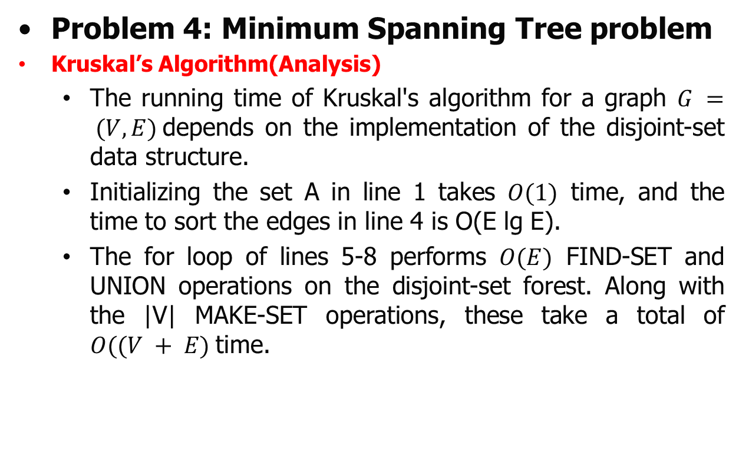
Greedy Algorithm
Problem 4: Minimum Spanning Tree problem
Kruskal’s Algorithm(Analysis)
  The running time of Kruskal's algorithm for a graph $G = (V, E)$depends on the implementation of the disjoint-set data structure.
  Initializing the set A in line 1 takes $O(1)$ time, and the time to sort the edges in line 4 is O(E lg E).
  The for loop of lines 5-8 performs $O(E)$ FIND-SET and UNION operations on the disjoint-set forest. Along with the |V| MAKE-SET operations, these take a total of $O((V + E)$time.

Slide 40
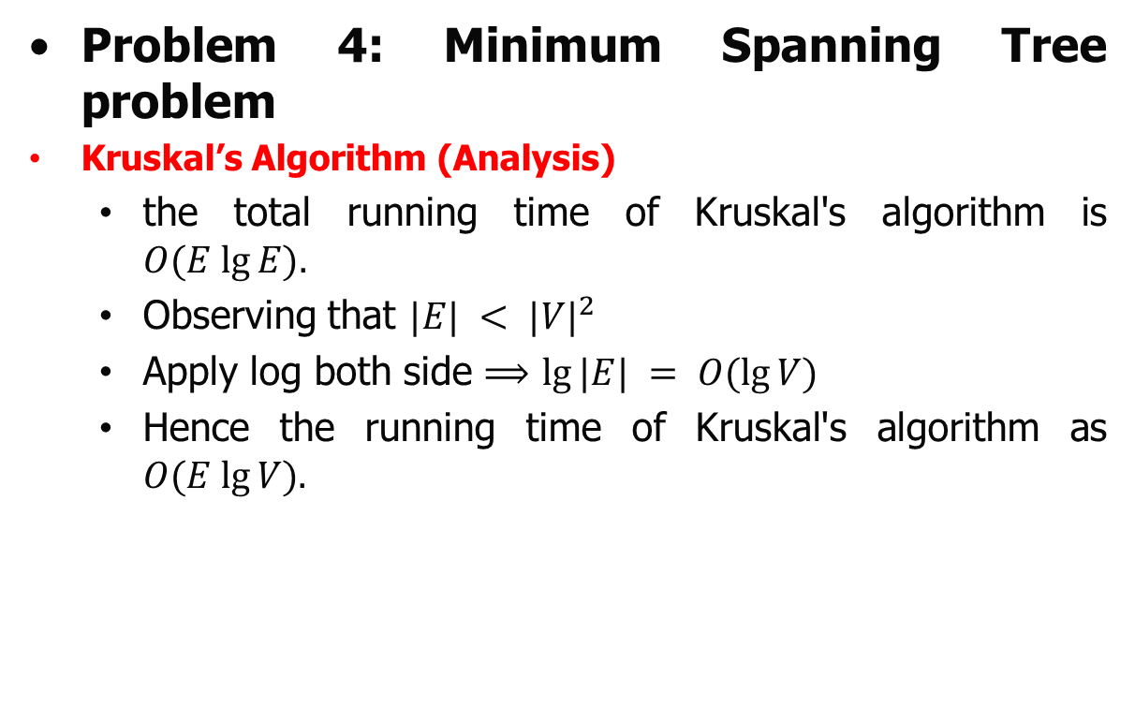
Greedy Algorithm
Problem 4: Minimum Spanning Tree problem
Kruskal’s Algorithm (Analysis)
  the total running time of Kruskal's algorithm is $O(E lg⁡E).$
  Observing that $|E| < {|V|}^{2}$
  Apply log both side $⟹$ $lg⁡|E| = O(lg⁡V)$
  Hence the running time of Kruskal's algorithm as $O(E lg⁡V).$

Slide 41
Greedy Algorithm
Problem 4: Minimum Spanning Tree problem
Kruskal’s Algorithm:
Example 2: Construct the minimum spanning tree (MST) for the given graph using Kruskal’s Algorithm-
28
Self Practice
b
c
10
14
16
a
e
d
24
18
25
f
g
12
22

Slide 42
Greedy Algorithm
Problem 4: Minimum Spanning Tree problem
  Kruskal’s Algorithm
    Concept and Examples
  Prim’s Algorithm
    Concept and Examples

Slide 43
Greedy Algorithm
Problem 4: Minimum Spanning Tree problem
Prim’s Algorithm
  Prim’s Algorithm is a famous greedy algorithm.
  It is used for finding the Minimum Spanning Tree (MST) of a given graph.
  To apply Prim’s algorithm, the given graph must be weighted, connected and undirected.

Slide 44
Greedy Algorithm
Problem 4: Minimum Spanning Tree problem
Prim’s Algorithm (Implimentation)
  The implementation of Prim’s Algorithm is explained in the following steps-
  Step-1:
    Randomly choose any vertex.
    The vertex connecting to the edge having least weight is usually selected.

Slide 45
Greedy Algorithm
Problem 4: Minimum Spanning Tree problem
Prim’s Algorithm (Implementation)
  Step-2:
    Find all the edges that connect the tree to new vertices.
    Find the least weight edge among those edges and include it in the existing tree.
    If including that edge creates a cycle, then reject that edge and look for the next least weight edge.
  Step-03:
    Keep repeating step-2 until all the vertices are included and Minimum Spanning Tree (MST) is obtained.

Slide 46
Greedy Algorithm
Problem 4: Minimum Spanning Tree problem
Prim’s Algorithm (Implementation)
  Step-2:
    Find all the edges that connect the tree to new vertices.
    Find the least weight edge among those edges and include it in the existing tree.
    If including that edge creates a cycle, then reject that edge and look for the next least weight edge.
  Step-03:
    Keep repeating step-2 until all the vertices are included and Minimum Spanning Tree (MST) is obtained.

Slide 47
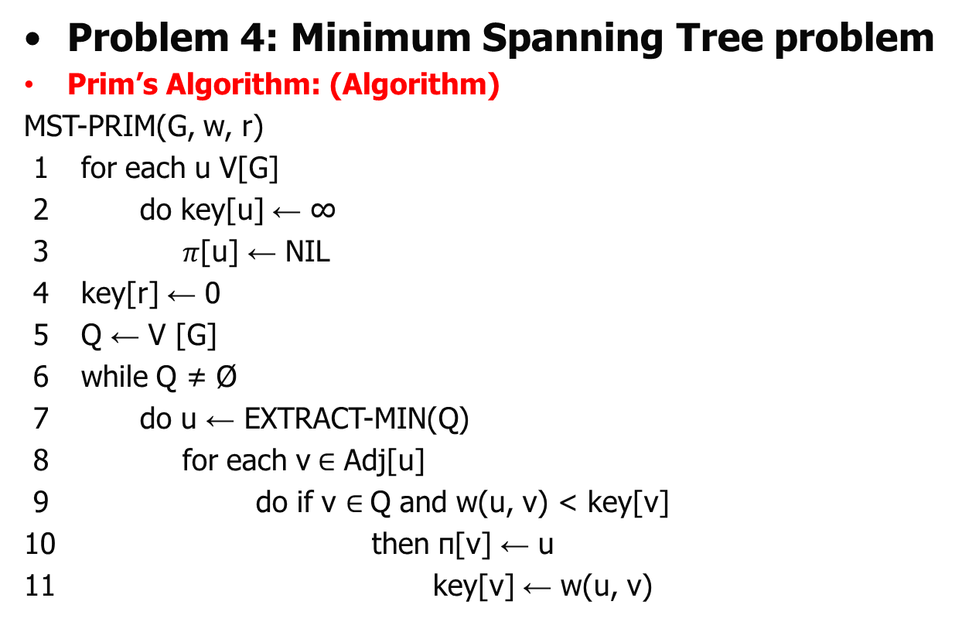
Greedy Algorithm
Problem 4: Minimum Spanning Tree problem
Prim’s Algorithm: (Algorithm)
MST-PRIM(G, w, r)
1 for each u V[G]
2 do key[u] ← ∞
3 $π$[u] ← NIL
4 key[r] ← 0
5 Q ← V [G]
6 while Q ≠ Ø
7 do u ← EXTRACT-MIN(Q)
8 for each v$∈$ Adj[u]
9 do if v $∈$Q and w(u, v) < key[v]
10 then π[v] ← u
11 key[v] ← w(u, v)

Slide 48
Greedy Algorithm
Problem 4: Minimum Spanning Tree problem
Prim’s Algorithm:
Example 1: Construct the minimum spanning tree (MST) for the given graph using Prim’s Algorithm-
8
7
b
c
d
4
9
2
a
11
i
14
e
4
7
6
8
10
h
g
f
1
2

Slide 49
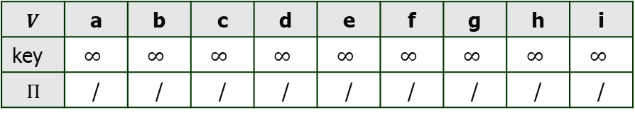
Greedy Algorithm
Problem 4: Minimum Spanning Tree problem
Prim’s Algorithm:
Example 1: Construct the minimum spanning tree (MST) for the given graph using Prim’s Algorithm-
8
7
b
c
d
4
9
2
a
11
i
14
e
4
7
6
8
10
h
g
f
1
2
$$V$$ | a | b | c | d | e | f | g | h | i
key | $$∞$$ | $$∞$$ | $$∞$$ | $$∞$$ | $$∞$$ | $$∞$$ | $$∞$$ | $$∞$$ | $$∞$$
$$Π$$ | / | / | / | / | / | / | / | / | /

Slide 50
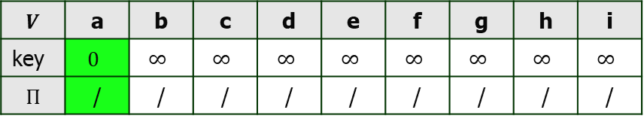
Greedy Algorithm
Problem 4: Minimum Spanning Tree problem
Prim’s Algorithm:
Example 1: Construct the minimum spanning tree (MST) for the given graph using Prim’s Algorithm-
8
7
b
c
d
Use step 1
Assume that ‘a’ is the root.
4
9
2
a
11
i
14
e
4
7
6
8
10
h
g
f
Q | a | b | c | d | e | f | g | h | i
1
2
$$V$$ | a | b | c | d | e | f | g | h | i
key | $$0$$ | $$∞$$ | $$∞$$ | $$∞$$ | $$∞$$ | $$∞$$ | $$∞$$ | $$∞$$ | $$∞$$
$$Π$$ | / | / | / | / | / | / | / | / | /

Slide 51

Greedy Algorithm
Problem 4: Minimum Spanning Tree problem
Prim’s Algorithm:
Example 1: Construct the minimum spanning tree (MST) for the given graph using Prim’s Algorithm-
8
7
Use step 1
b
c
d
4
9
2
a
11
i
14
e
4
7
6
8
10
h
g
f
Q | a | b | c | d | e | f | g | h | i
1
2
$$V$$ | a | b | c | d | e | f | g | h | i
key | $$0$$ | $$4$$ | $$∞$$ | $$∞$$ | $$∞$$ | $$∞$$ | $$∞$$ | $$8$$ | $$∞$$
$$Π$$ | / | a | / | / | / | / | / | a | /

Slide 52
Greedy Algorithm
Problem 4: Minimum Spanning Tree problem
Prim’s Algorithm:
Example 1: Construct the minimum spanning tree (MST) for the given graph using Prim’s Algorithm-
Min
8
7
b
c
d
Use step 1
4
9
2
a
11
i
14
e
4
7
6
8
10
h
g
f
Q | a | b | c | d | e | f | g | h | i
1
2
$$V$$ | a | b | c | d | e | f | g | h | i
key | $$0$$ | $$4$$ | $$∞$$ | $$∞$$ | $$∞$$ | $$∞$$ | $$∞$$ | $$8$$ | $$∞$$
$$Π$$ | / | a | / | / | / | / | / | a | /

Slide 53
Greedy Algorithm
Problem 4: Minimum Spanning Tree problem
Prim’s Algorithm:
Example 1: Construct the minimum spanning tree (MST) for the given graph using Prim’s Algorithm-
8
7
b
c
d
Use step 1
4
9
2
a
11
i
14
e
4
7
6
8
10
h
g
f
Q | a | b | c | d | e | f | g | h | i
1
2
$$V$$ | a | b | c | d | e | f | g | h | i
key | $$0$$ | $$4$$ | $$∞$$ | $$∞$$ | $$∞$$ | $$∞$$ | $$∞$$ | $$8$$ | $$∞$$
$$Π$$ | / | a | / | / | / | / | / | a | /

Slide 54
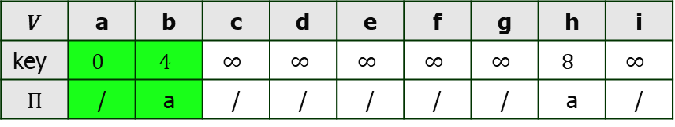
Greedy Algorithm
Problem 4: Minimum Spanning Tree problem
Prim’s Algorithm:
Example 1: Construct the minimum spanning tree (MST) for the given graph using Kruskal’s Algorithm-
8
7
b
c
d
Use step 2 and 3 until MST form
4
9
2
a
11
i
14
e
4
7
6
8
10
h
g
f
Q | a | b | c | d | e | f | g | h | i
1
2
$$V$$ | a | b | c | d | e | f | g | h | i
key | $$0$$ | $$4$$ | $$∞$$ | $$∞$$ | $$∞$$ | $$∞$$ | $$∞$$ | $$8$$ | $$∞$$
$$Π$$ | / | a | / | / | / | / | / | a | /

Slide 55

Greedy Algorithm
Problem 4: Minimum Spanning Tree problem
Prim’s Algorithm:
Example 1: Construct the minimum spanning tree (MST) for the given graph using Prim’s Algorithm-
8
7
b
c
d
Use step 2 and 3 until MST form
4
9
2
a
11
i
14
e
4
7
6
8
10
h
g
f
Q | a | b | c | d | e | f | g | h | i
1
2
$$V$$ | a | b | c | d | e | f | g | h | i
key | $$0$$ | $$4$$ | $$8$$ | $$∞$$ | $$∞$$ | $$∞$$ | $$∞$$ | $$8$$ | $$∞$$
$$Π$$ | / | a | b | / | / | / | / | a | /

Slide 56
Greedy Algorithm
Problem 4: Minimum Spanning Tree problem
Prim’s Algorithm:
Example 1: Construct the minimum spanning tree (MST) for the given graph using Prim’s Algorithm-
Min
8
7
b
c
d
Use step 2 and 3 until MST form
4
9
2
a
11
i
14
e
4
7
6
8
10
h
g
f
Q | a | b | c | d | e | f | g | h | i
1
2
$$V$$ | a | b | c | d | e | f | g | h | i
key | $$0$$ | $$4$$ | $$8$$ | $$∞$$ | $$∞$$ | $$∞$$ | $$∞$$ | $$8$$ | $$∞$$
$$Π$$ | / | a | b | / | / | / | / | a | /

Slide 57
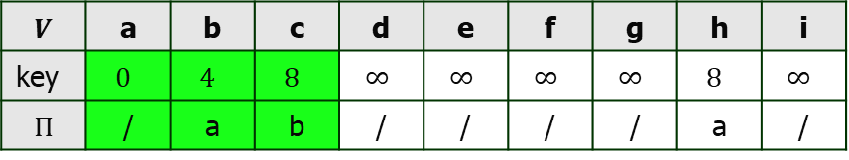
Greedy Algorithm
Problem 4: Minimum Spanning Tree problem
Prim’s Algorithm:
Example 1: Construct the minimum spanning tree (MST) for the given graph using Prim’s Algorithm-
8
7
b
c
d
Use step 2 and 3 until MST form
4
9
2
a
11
i
14
e
4
7
6
8
10
h
g
f
Q | a | b | c | d | e | f | g | h | i
1
2
$$V$$ | a | b | c | d | e | f | g | h | i
key | $$0$$ | $$4$$ | $$8$$ | $$∞$$ | $$∞$$ | $$∞$$ | $$∞$$ | $$8$$ | $$∞$$
$$Π$$ | / | a | b | / | / | / | / | a | /

Slide 58
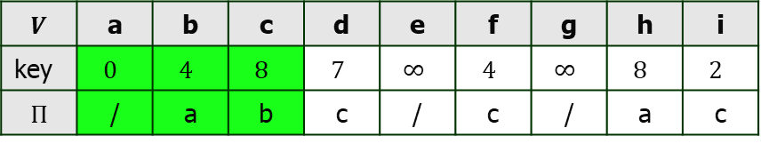
Greedy Algorithm
Problem 4: Minimum Spanning Tree problem
Prim’s Algorithm:
Example 1: Construct the minimum spanning tree (MST) for the given graph using Prim’s Algorithm-
8
7
b
c
d
Use step 2 and 3 until MST form
4
9
2
a
11
i
14
e
4
7
6
8
10
h
g
f
Q | a | b | c | d | e | f | g | h | i
1
2
$$V$$ | a | b | c | d | e | f | g | h | i
key | $$0$$ | $$4$$ | $$8$$ | $$7$$ | $$∞$$ | $$4$$ | $$∞$$ | $$8$$ | $$2$$
$$Π$$ | / | a | b | c | / | c | / | a | c

Slide 59
Greedy Algorithm
Problem 4: Minimum Spanning Tree problem
Prim’s Algorithm:
Example 1: Construct the minimum spanning tree (MST) for the given graph using Prim’s Algorithm-
Min
8
7
b
c
d
Use step 2 and 3 until MST form
4
9
2
a
11
i
14
e
4
7
6
8
10
h
g
f
Q | a | b | c | d | e | f | g | h | i
1
2
$$V$$ | a | b | c | d | e | f | g | h | i
key | $$0$$ | $$4$$ | $$8$$ | $$7$$ | $$∞$$ | $$4$$ | $$∞$$ | $$8$$ | $$2$$
$$Π$$ | / | a | b | c | / | c | / | a | c

Slide 60
Greedy Algorithm
Problem 4: Minimum Spanning Tree problem
Prim’s Algorithm:
Example 1: Construct the minimum spanning tree (MST) for the given graph using Prim’s Algorithm-
Min
8
7
b
c
d
Use step 2 and 3 until MST form
4
9
2
a
11
i
14
e
4
7
6
8
10
h
g
f
Q | a | b | c | d | e | f | g | h | i
1
2
$$V$$ | a | b | c | d | e | f | g | h | i
key | $$0$$ | $$4$$ | $$8$$ | $$7$$ | $$∞$$ | $$4$$ | $$∞$$ | $$8$$ | $$2$$
$$Π$$ | / | a | b | c | / | c | / | a | c

Slide 61
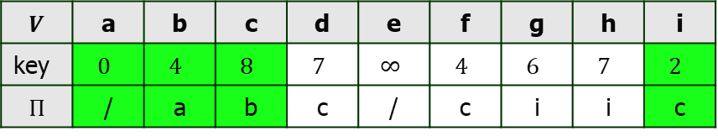
Greedy Algorithm
Problem 4: Minimum Spanning Tree problem
Prim’s Algorithm:
Example 1: Construct the minimum spanning tree (MST) for the given graph using Prim’s Kruskal’s Algorithm-
8
7
b
c
d
Use step 2 and 3 until MST form
4
9
2
a
11
i
14
e
4
7
6
8
10
h
g
f
Q | a | b | c | d | e | f | g | h | i
1
2
$$V$$ | a | b | c | d | e | f | g | h | i
key | $$0$$ | $$4$$ | $$8$$ | $$7$$ | $$∞$$ | $$4$$ | $$6$$ | $$7$$ | $$2$$
$$Π$$ | / | a | b | c | / | c | i | i | c

Slide 62
Greedy Algorithm
Problem 4: Minimum Spanning Tree problem
Prim’s Algorithm:
Example 1: Construct the minimum spanning tree (MST) for the given graph using Prim’s Algorithm-
8
7
b
c
d
Use step 2 and 3 until MST form
4
9
2
a
11
i
14
e
4
7
6
8
10
h
g
f
Q | a | b | c | d | e | f | g | h | i
1
2
$$V$$ | a | b | c | d | e | f | g | h | i
key | $$0$$ | $$4$$ | $$8$$ | $$7$$ | $$∞$$ | $$4$$ | $$6$$ | $$7$$ | $$2$$
$$Π$$ | / | a | b | c | / | c | i | i | c

Slide 63
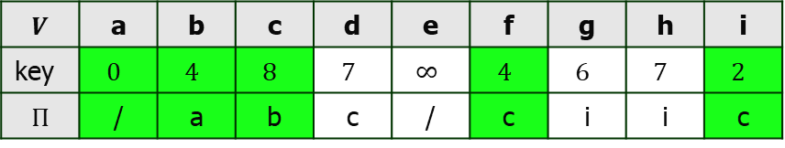
Greedy Algorithm
Problem 4: Minimum Spanning Tree problem
Prim’s Algorithm:
Example 1: Construct the minimum spanning tree (MST) for the given graph using Prim’s Algorithm-
8
7
b
c
d
Use step 2 and 3 until MST form
4
9
2
a
11
i
14
e
4
7
6
8
10
h
g
f
Q | a | b | c | d | e | f | g | h | i
1
2
$$V$$ | a | b | c | d | e | f | g | h | i
key | $$0$$ | $$4$$ | $$8$$ | $$7$$ | $$∞$$ | $$4$$ | $$6$$ | $$7$$ | $$2$$
$$Π$$ | / | a | b | c | / | c | i | i | c

Slide 64

Greedy Algorithm
Problem 4: Minimum Spanning Tree problem
Prim’s Algorithm:
Example 1: Construct the minimum spanning tree (MST) for the given graph using Prim’s Algorithm-
8
7
b
c
d
Use step 2 and 3 until MST form
4
9
2
a
11
i
14
e
4
7
6
8
10
h
g
f
Q | a | b | c | d | e | f | g | h | i
1
2
$$V$$ | a | b | c | d | e | f | g | h | i
key | $$0$$ | $$4$$ | $$8$$ | $$7$$ | $$10$$ | $$4$$ | $$2$$ | $$7$$ | $$2$$
$$Π$$ | / | a | b | c | f | c | f | i | c

Slide 65
Greedy Algorithm
Problem 4: Minimum Spanning Tree problem
Prim’s Algorithm:
Example 1: Construct the minimum spanning tree (MST) for the given graph using Prim’s Algorithm-
8
7
b
c
d
Use step 2 and 3 until MST form
4
9
2
a
11
i
14
e
4
7
6
8
10
h
g
f
Q | a | b | c | d | e | f | g | h | i
1
2
$$V$$ | a | b | c | d | e | f | g | h | i
key | $$0$$ | $$4$$ | $$8$$ | $$7$$ | $$10$$ | $$4$$ | $$2$$ | $$7$$ | $$2$$
$$Π$$ | / | a | b | c | f | c | f | i | c
Min

Slide 66
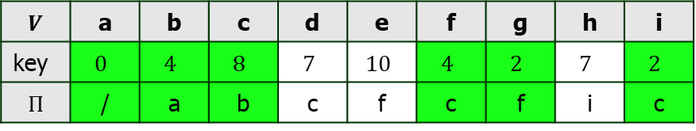
Greedy Algorithm
Problem 4: Minimum Spanning Tree problem
Prim’s Algorithm:
Example 1: Construct the minimum spanning tree (MST) for the given graph using Prim’s Algorithm-
8
7
b
c
d
Use step 2 and 3 until MST form
4
9
2
a
11
i
14
e
4
7
6
8
10
h
g
f
Q | a | b | c | d | e | f | g | h | i
1
2
$$V$$ | a | b | c | d | e | f | g | h | i
key | $$0$$ | $$4$$ | $$8$$ | $$7$$ | $$10$$ | $$4$$ | $$2$$ | $$7$$ | $$2$$
$$Π$$ | / | a | b | c | f | c | f | i | c

Slide 67

Greedy Algorithm
Problem 4: Minimum Spanning Tree problem
Prim’s Algorithm:
Example 1: Construct the minimum spanning tree (MST) for the given graph using Prim’s Algorithm-
8
7
b
c
d
Use step 2 and 3 until MST form
4
9
2
a
11
i
14
e
4
7
6
8
10
h
g
f
Q | a | b | c | d | e | f | g | h | i
1
2
$$V$$ | a | b | c | d | e | f | g | h | i
key | $$0$$ | $$4$$ | $$8$$ | $$7$$ | $$10$$ | $$4$$ | $$2$$ | $$1$$ | $$2$$
$$Π$$ | / | a | b | c | f | c | f | g | c

Slide 68
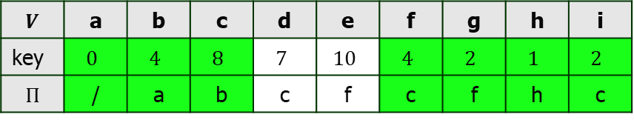
Greedy Algorithm
Problem 4: Minimum Spanning Tree problem
Prim’s Algorithm:
Example 1: Construct the minimum spanning tree (MST) for the given graph using Prim’s Algorithm-
8
7
b
c
d
Use step 2 and 3 until MST form
4
9
2
a
11
i
14
e
4
7
6
8
10
h
g
f
Q | a | b | c | d | e | f | g | h | i
1
2
Min
$$V$$ | a | b | c | d | e | f | g | h | i
key | $$0$$ | $$4$$ | $$8$$ | $$7$$ | $$10$$ | $$4$$ | $$2$$ | $$1$$ | $$2$$
$$Π$$ | / | a | b | c | f | c | f | h | c

Slide 69
Greedy Algorithm
Problem 4: Minimum Spanning Tree problem
Prim’s Algorithm:
Example 1: Construct the minimum spanning tree (MST) for the given graph using Prim’s Algorithm-
8
7
b
c
d
Use step 2 and 3 until MST form
4
9
2
a
11
i
14
e
4
7
6
8
10
h
g
f
Q | a | b | c | d | e | f | g | h | i
1
2
$$V$$ | a | b | c | d | e | f | g | h | i
key | $$0$$ | $$4$$ | $$8$$ | $$7$$ | $$10$$ | $$4$$ | $$2$$ | $$1$$ | $$2$$
$$Π$$ | / | a | b | c | f | c | f | h | c

Slide 70
Greedy Algorithm
Problem 4: Minimum Spanning Tree problem
Prim’s Algorithm:
Example 1: Construct the minimum spanning tree (MST) for the given graph using Prim’s Algorithm-
8
7
b
c
d
Use step 2 and 3 until MST form
4
9
2
a
11
i
14
e
4
7
6
8
10
h
g
f
Q | a | b | c | d | e | f | g | h | i
1
2
$$V$$ | a | b | c | d | e | f | g | h | i
key | $$0$$ | $$4$$ | $$8$$ | $$7$$ | $$10$$ | $$4$$ | $$2$$ | $$1$$ | $$2$$
$$Π$$ | / | a | b | c | f | c | f | h | c

Slide 71
Greedy Algorithm
Problem 4: Minimum Spanning Tree problem
Prim’s Algorithm:
Example 1: Construct the minimum spanning tree (MST) for the given graph using Prim’s Algorithm-
8
7
b
c
d
Use step 2 and 3 until MST form
4
9
2
a
11
i
14
e
4
7
6
8
10
h
g
f
Q | a | b | c | d | e | f | g | h | i
Min
1
2
$$V$$ | a | b | c | d | e | f | g | h | i
key | $$0$$ | $$4$$ | $$8$$ | $$7$$ | $$10$$ | $$4$$ | $$2$$ | $$1$$ | $$2$$
$$Π$$ | / | a | b | c | f | c | f | h | c

Slide 72
Greedy Algorithm
Problem 4: Minimum Spanning Tree problem
Prim’s Algorithm:
Example 1: Construct the minimum spanning tree (MST) for the given graph using Prim’s Algorithm-
8
7
b
c
d
Use step 2 and 3 until MST form
4
9
2
a
11
i
14
e
4
7
6
8
10
h
g
f
Q | a | b | c | d | e | f | g | h | i
Min
1
2
cycle
$$V$$ | a | b | c | d | e | f | g | h | i
key | $$0$$ | $$4$$ | $$8$$ | $$7$$ | $$10$$ | $$4$$ | $$2$$ | $$1$$ | $$2$$
$$Π$$ | / | a | b | c | f | c | f | h | c

Slide 73
Greedy Algorithm
Problem 4: Minimum Spanning Tree problem
Prim’s Algorithm:
Example 1: Construct the minimum spanning tree (MST) for the given graph using Prim’s Algorithm-
8
7
b
c
d
Use step 2 and 3 until MST form
4
9
2
a
11
i
14
e
X
4
7
6
8
10
h
g
f
Q | a | b | c | d | e | f | g | h | i
Min
1
2
cycle
$$V$$ | a | b | c | d | e | f | g | h | i
key | $$0$$ | $$4$$ | $$8$$ | $$7$$ | $$10$$ | $$4$$ | $$2$$ | $$1$$ | $$2$$
$$Π$$ | / | a | b | c | f | c | f | h | c

Slide 74
Greedy Algorithm
Problem 4: Minimum Spanning Tree problem
Prim’s Algorithm:
Example 1: Construct the minimum spanning tree (MST) for the given graph using Prim’s Algorithm-
8
7
b
c
d
Use step 2 and 3 until MST form
4
9
2
a
11
i
14
e
X
4
7
6
8
10
h
g
f
Q | a | b | c | d | e | f | g | h | i
Min
1
2
$$V$$ | a | b | c | d | e | f | g | h | i
key | $$0$$ | $$4$$ | $$8$$ | $$7$$ | $$10$$ | $$4$$ | $$2$$ | $$1$$ | $$2$$
$$Π$$ | / | a | b | c | f | c | f | h | c

Slide 75
Greedy Algorithm
Problem 4: Minimum Spanning Tree problem
Prim’s Algorithm:
Example 1: Construct the minimum spanning tree (MST) for the given graph using Prim’s Algorithm-
8
7
b
c
d
Use step 2 and 3 until MST form
4
9
2
a
11
i
14
e
X
4
7
6
8
10
h
g
f
Q | a | b | c | d | e | f | g | h | i
Min
1
2
cycle
$$V$$ | a | b | c | d | e | f | g | h | i
key | $$0$$ | $$4$$ | $$8$$ | $$7$$ | $$10$$ | $$4$$ | $$2$$ | $$1$$ | $$2$$
$$Π$$ | / | a | b | c | f | c | f | h | c

Slide 76
Greedy Algorithm
Problem 4: Minimum Spanning Tree problem
Prim’s Algorithm:
Example 1: Construct the minimum spanning tree (MST) for the given graph using Prim’s Algorithm-
8
7
b
c
d
Use step 2 and 3 until MST form
4
9
2
a
11
i
14
e
X
4
X
7
6
8
10
h
g
f
Q | a | b | c | d | e | f | g | h | i
Min
1
2
cycle
$$V$$ | a | b | c | d | e | f | g | h | i
key | $$0$$ | $$4$$ | $$8$$ | $$7$$ | $$10$$ | $$4$$ | $$2$$ | $$1$$ | $$2$$
$$Π$$ | / | a | b | c | f | c | f | h | c

Slide 77
Greedy Algorithm
Problem 4: Minimum Spanning Tree problem
Prim’s Algorithm:
Example 1: Construct the minimum spanning tree (MST) for the given graph using Prim’s Algorithm-
8
7
b
c
d
Use step 2 and 3 until MST form
4
9
2
a
11
i
14
e
X
4
X
7
6
8
10
h
g
f
Q | a | b | c | d | e | f | g | h | i
1
2
$$V$$ | a | b | c | d | e | f | g | h | i
key | $$0$$ | $$4$$ | $$8$$ | $$7$$ | $$10$$ | $$4$$ | $$2$$ | $$1$$ | $$2$$
$$Π$$ | / | a | b | c | f | c | f | h | c

Slide 78
Greedy Algorithm
Problem 4: Minimum Spanning Tree problem
Prim’s Algorithm:
Example 1: Construct the minimum spanning tree (MST) for the given graph using Prim’s Algorithm-
Min
8
7
b
c
d
Use step 2 and 3 until MST form
4
9
2
a
11
i
14
e
X
4
X
7
6
8
10
h
g
f
Q | a | b | c | d | e | f | g | h | i
1
2
$$V$$ | a | b | c | d | e | f | g | h | i
key | $$0$$ | $$4$$ | $$8$$ | $$7$$ | $$10$$ | $$4$$ | $$2$$ | $$1$$ | $$2$$
$$Π$$ | / | a | b | c | f | c | f | h | c

Slide 79
Greedy Algorithm
Problem 4: Minimum Spanning Tree problem
Prim’s Algorithm:
Example 1: Construct the minimum spanning tree (MST) for the given graph using Prim’s Algorithm-
8
7
b
c
d
Use step 2 and 3 until MST form
4
9
2
a
11
i
14
e
X
4
X
7
6
8
10
h
g
f
Q | a | b | c | d | e | f | g | h | i
1
2
$$V$$ | a | b | c | d | e | f | g | h | i
key | $$0$$ | $$4$$ | $$8$$ | $$7$$ | $$10$$ | $$4$$ | $$2$$ | $$1$$ | $$2$$
$$Π$$ | / | a | b | c | f | c | f | h | c

Slide 80
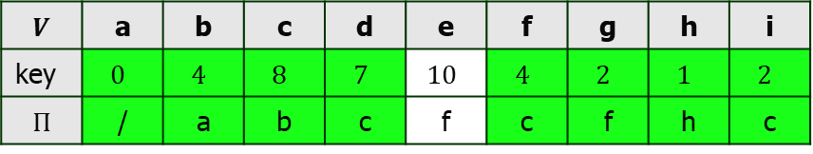
Greedy Algorithm
Problem 4: Minimum Spanning Tree problem
Prim’s Algorithm:
Example 1: Construct the minimum spanning tree (MST) for the given graph using Prim’s Algorithm-
8
7
b
c
d
Use step 2 and 3 until MST form
4
9
2
a
11
i
14
e
X
4
X
7
6
8
10
h
g
f
Q | a | b | c | d | e | f | g | h | i
1
2
$$V$$ | a | b | c | d | e | f | g | h | i
key | $$0$$ | $$4$$ | $$8$$ | $$7$$ | $$10$$ | $$4$$ | $$2$$ | $$1$$ | $$2$$
$$Π$$ | / | a | b | c | f | c | f | h | c

Slide 81

Greedy Algorithm
Problem 4: Minimum Spanning Tree problem
Prim’s Algorithm:
Example 1: Construct the minimum spanning tree (MST) for the given graph using Prim’s Algorithm-
8
7
b
c
d
Use step 2 and 3 until MST form
4
9
2
a
11
i
14
e
X
4
X
7
6
8
10
h
g
f
Q | a | b | c | d | e | f | g | h | i
1
2
$$V$$ | a | b | c | d | e | f | g | h | i
key | $$0$$ | $$4$$ | $$8$$ | $$7$$ | $$9$$ | $$4$$ | $$2$$ | $$1$$ | $$2$$
$$Π$$ | / | a | b | c | d | c | f | h | c

Slide 82
Greedy Algorithm
Problem 4: Minimum Spanning Tree problem
Prim’s Algorithm:
Example 1: Construct the minimum spanning tree (MST) for the given graph using Prim’s Algorithm-
8
7
b
c
d
Use step 2 and 3 until MST form
4
9
2
a
11
i
14
e
X
4
X
7
6
8
10
h
g
f
Q | a | b | c | d | e | f | g | h | i
1
2
Min
$$V$$ | a | b | c | d | e | f | g | h | i
key | $$0$$ | $$4$$ | $$8$$ | $$7$$ | $$9$$ | $$4$$ | $$2$$ | $$1$$ | $$2$$
$$Π$$ | / | a | b | c | d | c | f | h | c

Slide 83
Greedy Algorithm
Problem 4: Minimum Spanning Tree problem
Prim’s Algorithm:
Example 1: Construct the minimum spanning tree (MST) for the given graph using Prim’s Algorithm-
8
7
b
c
d
Use step 2 and 3 until MST form
4
9
2
a
11
i
14
e
X
4
X
7
6
8
10
cycle
h
g
f
1
Q | a | b | c | d | e | f | g | h | i
2
Min
$$V$$ | a | b | c | d | e | f | g | h | i
key | $$0$$ | $$4$$ | $$8$$ | $$7$$ | $$9$$ | $$4$$ | $$2$$ | $$1$$ | $$2$$
$$Π$$ | / | a | b | c | d | c | f | h | c

Slide 84
Greedy Algorithm
Problem 4: Minimum Spanning Tree problem
Prim’s Algorithm:
Example 1: Construct the minimum spanning tree (MST) for the given graph using Prim’s Algorithm-
8
7
b
c
d
Use step 2 and 3 until MST form
4
9
2
a
11
i
14
e
X
X
4
X
7
6
8
10
cycle
h
g
f
1
Q | a | b | c | d | e | f | g | h | i
2
Min
$$V$$ | a | b | c | d | e | f | g | h | i
key | $$0$$ | $$4$$ | $$8$$ | $$7$$ | $$9$$ | $$4$$ | $$2$$ | $$1$$ | $$2$$
$$Π$$ | / | a | b | c | d | c | f | h | c

Slide 85
Greedy Algorithm
Problem 4: Minimum Spanning Tree problem
Prim’s Algorithm:
Example 1: Construct the minimum spanning tree (MST) for the given graph using Prim’s Algorithm-
8
7
b
c
d
Use step 2 and 3 until MST form
4
9
2
a
11
i
14
e
X
X
4
X
7
6
8
10
h
g
f
Q | a | b | c | d | e | f | g | h | i
1
2
$$V$$ | a | b | c | d | e | f | g | h | i
key | $$0$$ | $$4$$ | $$8$$ | $$7$$ | $$9$$ | $$4$$ | $$2$$ | $$1$$ | $$2$$
$$Π$$ | / | a | b | c | d | c | f | h | c

Slide 86
Greedy Algorithm
Problem 4: Minimum Spanning Tree problem
Prim’s Algorithm:
Example 1: Construct the minimum spanning tree (MST) for the given graph using Prim’s Algorithm-
8
7
Min
b
c
d
Use step 2 and 3 until MST form
4
9
2
a
11
i
14
e
X
X
4
X
7
6
8
10
h
g
f
Q | a | b | c | d | e | f | g | h | i
1
2
$$V$$ | a | b | c | d | e | f | g | h | i
key | $$0$$ | $$4$$ | $$8$$ | $$7$$ | $$9$$ | $$4$$ | $$2$$ | $$1$$ | $$2$$
$$Π$$ | / | a | b | c | d | c | f | h | c

Slide 87
Greedy Algorithm
Problem 4: Minimum Spanning Tree problem
Prim’s Algorithm:
Example 1: Construct the minimum spanning tree (MST) for the given graph using Prim’s Algorithm-
8
7
b
c
d
Use step 2 and 3 until MST form
4
9
2
a
11
i
14
e
X
X
4
X
7
6
8
10
h
g
f
Q | a | b | c | d | e | f | g | h | i
1
2
$$V$$ | a | b | c | d | e | f | g | h | i
key | $$0$$ | $$4$$ | $$8$$ | $$7$$ | $$9$$ | $$4$$ | $$2$$ | $$1$$ | $$2$$
$$Π$$ | / | a | b | c | d | c | f | h | c

Slide 88
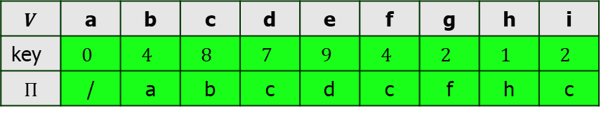
Greedy Algorithm
Problem 4: Minimum Spanning Tree problem
Prim’s Algorithm:
Example 1: Construct the minimum spanning tree (MST) for the given graph using Prim’s Algorithm-
8
7
b
c
d
Use step 2 and 3 until MST form
4
9
2
a
11
i
14
e
X
X
4
X
7
6
8
10
h
g
f
Q | a | b | c | d | e | f | g | h | i
1
2
$$V$$ | a | b | c | d | e | f | g | h | i
key | $$0$$ | $$4$$ | $$8$$ | $$7$$ | $$9$$ | $$4$$ | $$2$$ | $$1$$ | $$2$$
$$Π$$ | / | a | b | c | d | c | f | h | c

Slide 89
Greedy Algorithm
Problem 4: Minimum Spanning Tree problem
Prim’s Algorithm:
Example 1: Construct the minimum spanning tree (MST) for the given graph using Prim’s Algorithm-
Since all the vertices have been included in the MST, so stop the process.
Now, Cost of Minimum Spanning Tree
= Sum of all edge weights
= w[ab]+w[bc]+w[cd]+w[ci]+w[cf]+w[de]+w[gh]+w[fg]
=4+8+7+2+4+9+2+1+=37
8
7
b
c
d
4
9
Use step 2 and 3 until MST form
2
a
11
i
14
e
4
X
7
X
6
8
X
10
h
g
f
1
2

Slide 90
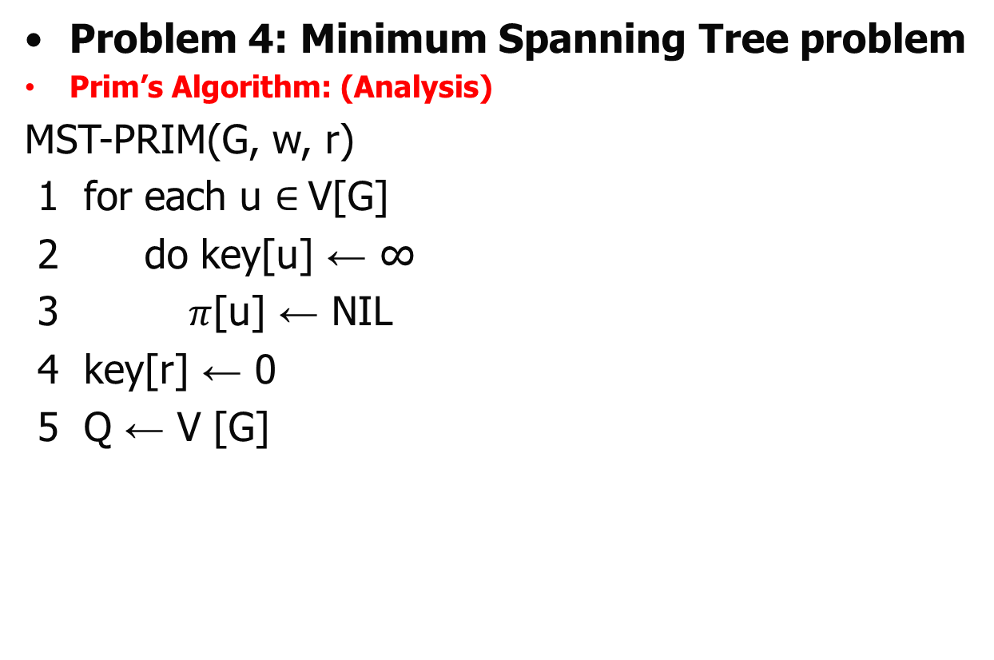



Greedy Algorithm
Problem 4: Minimum Spanning Tree problem
Prim’s Algorithm: (Analysis)
MST-PRIM(G, w, r)
1 for each u $∈$V[G]
2 do key[u] ← ∞
3 $π$[u] ← NIL
4 key[r] ← 0
5 Q ← V [G]
$$Ο(V)$$
$$Ο(1)$$
$Ο(1)$ by the help of Fibonacci Heap

Slide 91
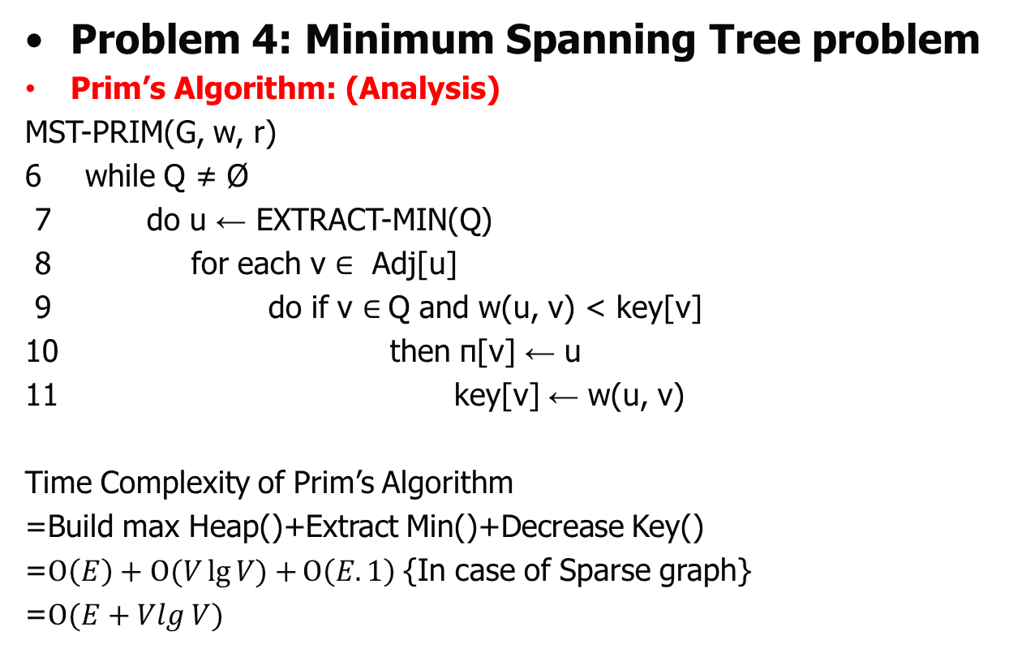




Greedy Algorithm
Problem 4: Minimum Spanning Tree problem
Prim’s Algorithm: (Analysis)
MST-PRIM(G, w, r)
6 while Q ≠ Ø
7 do u ← EXTRACT-MIN(Q)
8 for each v $∈$ Adj[u]
9 do if v $∈$Q and w(u, v) < key[v]
10 then π[v] ← u
11 key[v] ← w(u, v)
Time Complexity of Prim’s Algorithm
=Build max Heap()+Extract Min()+Decrease Key()
=$Ο\left(E\right)+Ο(V\lg{V)+}Ο\left(E.1\right)${In case of Sparse graph}
=$Ο(E+Vlg V)$
$$Ο(V\lg{V})$$
$$Ο(\lg{V})$$
$$Ο(V)$$
$$Ο(E)$$
$$Decrease Keyof Fibonacci Heap will take Ο(1)$$

Slide 92
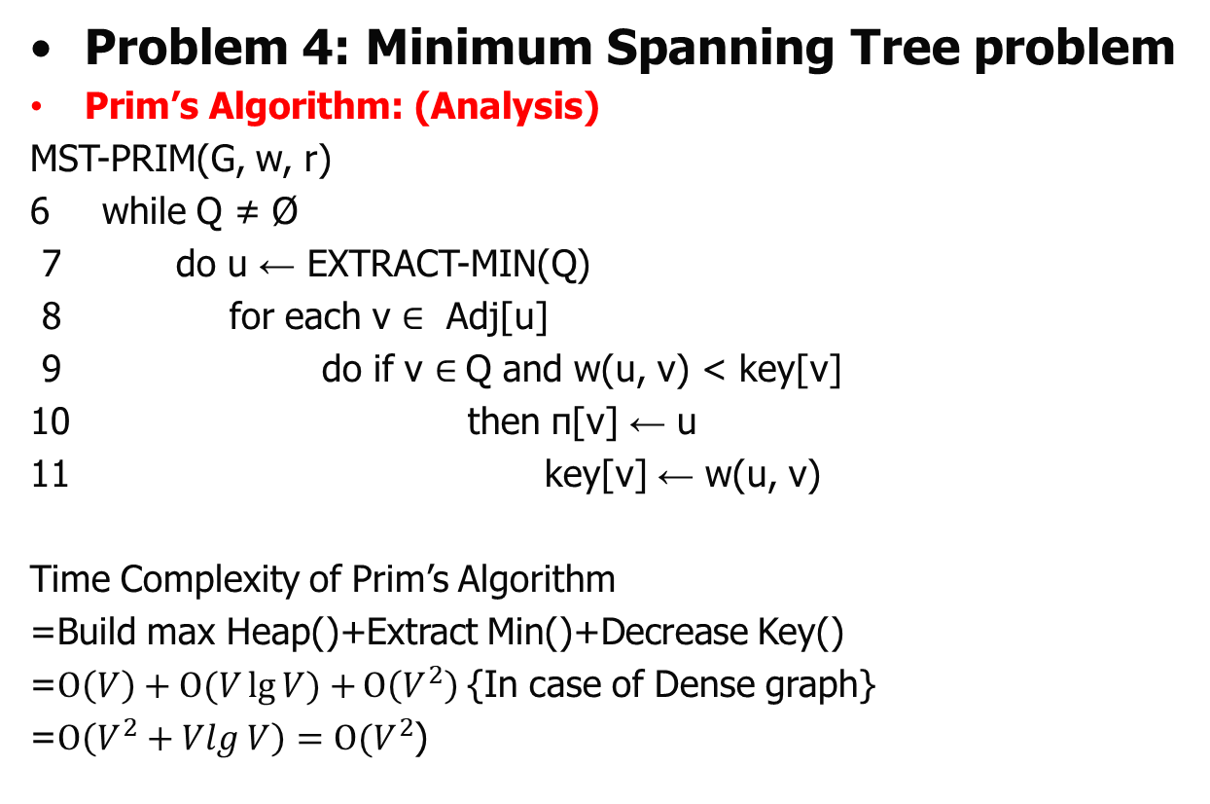
Greedy Algorithm
Problem 4: Minimum Spanning Tree problem
Prim’s Algorithm: (Analysis)
MST-PRIM(G, w, r)
6 while Q ≠ Ø
7 do u ← EXTRACT-MIN(Q)
8 for each v $∈$ Adj[u]
9 do if v $∈$Q and w(u, v) < key[v]
10 then π[v] ← u
11 key[v] ← w(u, v)
Time Complexity of Prim’s Algorithm
=Build max Heap()+Extract Min()+Decrease Key()
=$Ο\left(V\right)+Ο(V\lg{V)+}Ο\left(V^{2}\right)${In case of Dense graph}
=$Ο\left(V^{2}+Vlg V\right)=Ο(V^{2}$)
$$Ο(V\lg{V})$$
$$Ο(\lg{V})$$
$$Ο(V)$$
$$Ο(E)$$
$$Decrease Keyof Fibonacci Heap will take Ο(1)$$

Slide 93
Greedy Algorithm
Problem 4: Minimum Spanning Tree problem
Prim’s Algorithm:
Example 1: Construct the minimum spanning tree (MST) for the given graph using Prim’s Algorithm-
28
b
c
10
14
16
a
g
d
24
18
25
12
f
e
22

Slide 94

Thank U

